Slide 1
CPSC 355 Tutorials
External Text and Data

Slide 2
Covered
Linking external code
Makefiles
Calling external code
External Variables
Command Line Arguments
External of Pointer Arrays
Command Line arguments

Slide 3
1.
Linking External Code
All in link now

Slide 4
External Code
Organize your code
Call library functions
Optimize with Assembly
main.c
sum.s

Slide 5
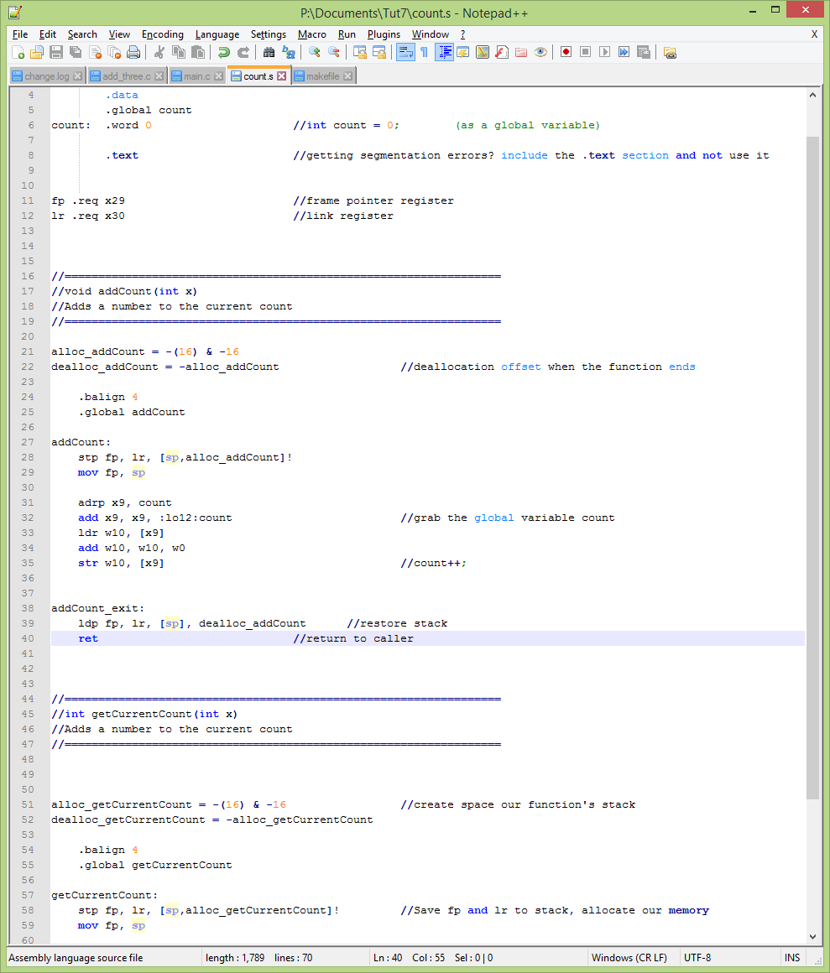
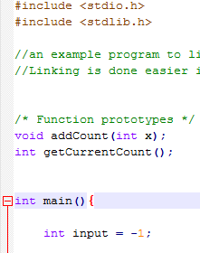
External Functions
Notes:
When you want to write some functions in assembly, make function prototypes to make them visible to your C code. When you compile, the C code will be able to find the functions in assembly when you link them together.

Slide 6
Compiling
gcc -c main.c
as sum.s -o sum.o
gcc *.o -o myprog
Notes:
Creates an object code file for main.c (C code)
Creates an object code file for sum.s (assembly)
Complies all files with the ‘.o’ extension and creates your program

Slide 7
Makefiles
Allows scripting for compiling
Multiple modes

Slide 8
Compiling with Makefiles
all:
gcc -c main.c
as sum.s -o sum.o
gcc *.o -o myprog
clean:
rm *.o
rm myprog
dance:
factor 72
Notes:
Here there are two functions you can run:
All is the default action the makefile will take when you don’t add options
Clean is a custom label, here I clean up all the o files that I left behind in the linking stage
You can make your own labels for your own purposes, make files are flexible
This is in a file called “makefile”

Slide 9
Running Makefiles
Save file with name “makefile”
Running:
make - runs the all section
make clean - runs the clean section

Slide 10
Calling External Functions
Make visible:
Assembly - with .global
C code - Function prototypes
Use the standard programming conventions
Notes:
Some examples of Standard Programming conventions:
Using w0-w7 as arguments
Using w0 as return
Using x8 as indirect return
Saving registers in a closed subroutine
Etc

Slide 11
Calling External Functions
Example
See files:
main.c
count.s
Makefile
count.c (example)
Notes:
Some examples of Standard Programming conventions:
Using w0-w7 as arguments
Using w0 as return
Using x8 as indirect return
Saving registers in a closed subroutine
Etc

Slide 12
2.
External Variables
Exposed!

Slide 13
External Variables
Recall: Strings
Stored in the Text section of memory
Address through:
Instructions adrp and add
Notes:
When we used strings, we used adrp and add to get the address of the string from the Text section. By default, everything is put in the .text section, unless otherwise specified

Slide 14
External Variables
OS
text
data
bss
Heap
Free memory
Stack

Slide 15
Text Section
OS
Read-only
Your code lives here
Strings
text
PC
data
bss
Heap
Free memory
Stack

Slide 16
Data Section
OS
Read/write
Programmer Initialized
text
data
bss
Heap
Free memory
Stack

Slide 17
BSS Section
OS
Block Starting Symbol
Read/write
Zero Initialized
text
data
bss
Heap
Free memory
Stack

Slide 18
Pseudo-ops
Pseudo-op | Size (bytes) | Uses
.string | - | Defines a string with a null termination character
.skip | - | Defines a block of memory, useful for arrays
.byte | 1 | Defines a byte, can also use as a char
.hword | 2 | short int
.word | 4 | int
.dword | 8 | long int
Notes:
Remember to manage the signage of these registers

Slide 19
External Variables
Example
See fill.c

Slide 20
External Variables
Putting it all together
Example
See
factmain.c
factorial.c
factorial.s

Slide 21
3.
External Array of Pointers
Pointy!

Slide 22
Strings in C
Recall: Strings in C have ‘\0’ at the end
This signifies, for most functions, the end of the string
You may need to concatenate this character back in when copying

Slide 23
External Array of Pointers
An array of Pointers to Pointers
Each element is dword sized (64-bits)

Slide 24
External Array of Pointers
.data
.data
.text
magicWords: .skip n*8
pointer to
magicWords[0]
pointer to
“Abra!!”
magicWords[1]
“Abracadabra”
magicWords[2]
“Bo”
magicWords[n]
...
Notes:
The label magicWords is the address to the start of the magicWords[] array in .data. Each element is 8 bytes long.
Each element in magicWords[] is a pointer to a string in .text.

Slide 25
External Array of Pointers
Example
See words.c

Slide 26
4.
Command Line Args
I command you!

Slide 27
Command Line Arguments
int main(int argc, char* argv[]){}
Argc (w0)
The number of arguments
Argv (x1)
A pointer to an array, whose contents are of pointers to strings
argv[0] is always the string command running your program
Notes:
As you would expect, you would find argc and argv in w0 and x1 respectively. Note that argv is a pointer to an array

Slide 28
Command Line Arguments
Example
See div.c

Slide 29

Thanks!
Any questions?
You can find me at:
kta@ucalgary.ca
Video: http://i.imgur.com/oF2Z2yr.gifv
Notes:
Slides from Slides Carnival

